Slide 1
Waste to Wealth

Slide 2
Proposed Company Name, Logo and Tagline
Trash Gold Pvt. Ltd.
Tagline: Trash to Cash!

Slide 3
Our philosophy
01
Mission
To provide an integrated solid waste management solution to the people of Bhopal by leveraging into the latest technology in solid waste management and enhance quality of life by being a community oriented and environmentally friendly firm.
02
Vision
To be a PROMINENT waste management company committed in promoting a CLEANER & HEALTHIER environment to the people and reduce the carbon footprint using innovation
03
Driving Values
We believe and stand firm with the company's core values of safety, accountability, responsibility, conservation, innovation, people empowerment and customer centric approach

Slide 4
Why Us?
Pay your Bill Online
Get Paperless Billing
Trash Collection from Home
Enroll in Autopay
See Pickup Schedules
Collect Green credits and Shop

Slide 5
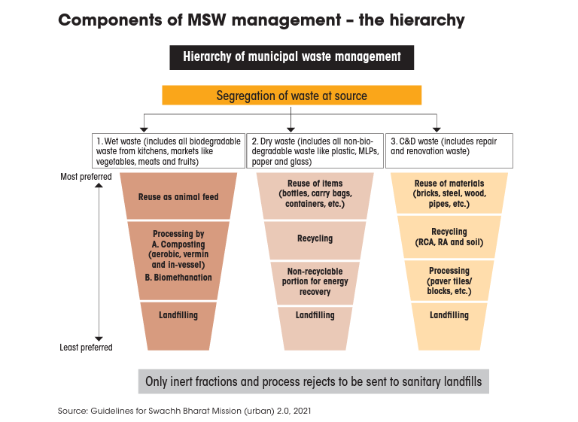

Slide 6
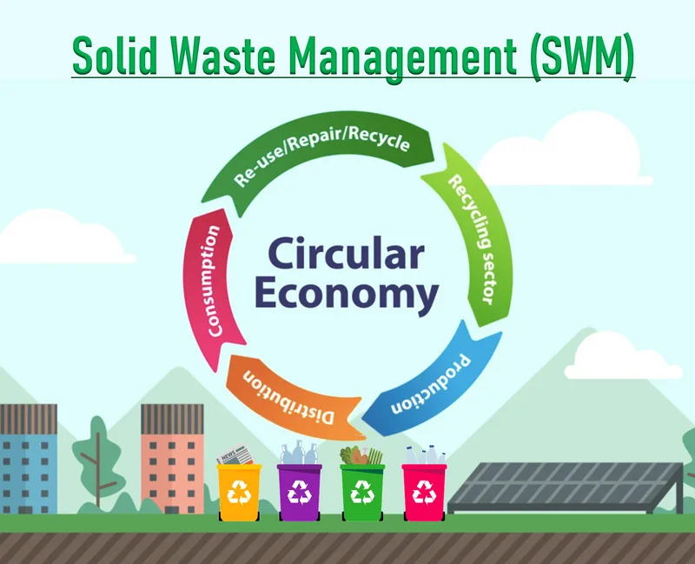

Slide 7
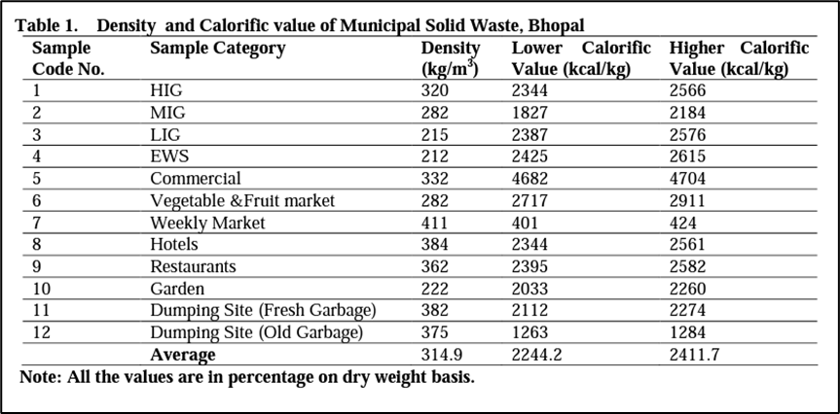
Study of Bhopal City Waste Management
CHARACTERIZATION OF THE MUNICIPAL SOLID WASTE IN BHOPAL
Ref: Katiyar, R.B., Suresh, S. and Sharma, A.K., 2013. Characterisation of municipal solid waste generated by the city of Bhopal, India. International Journal of ChemTech Research, 5(2), pp.623-628.

Slide 8
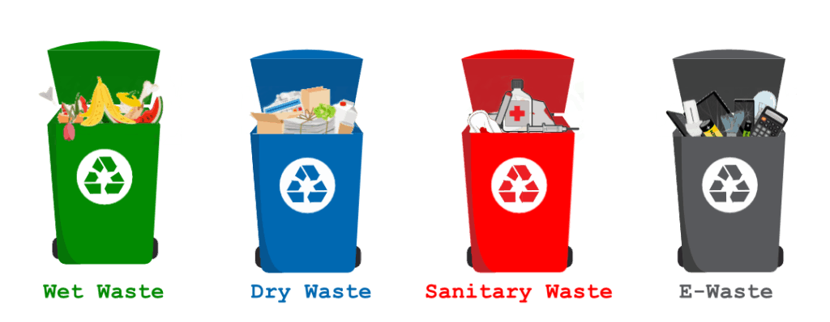
Marketing Efforts
Dustbin Color Coding Sensitization

Slide 9
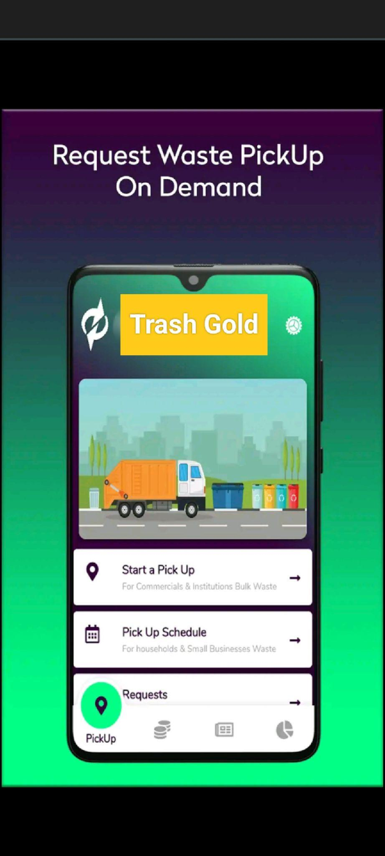
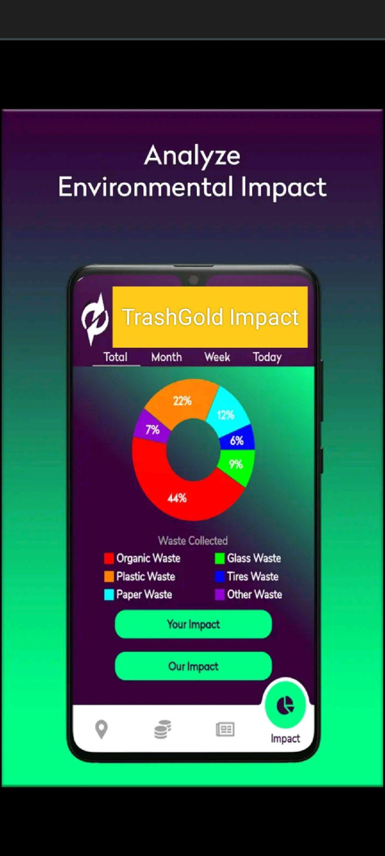
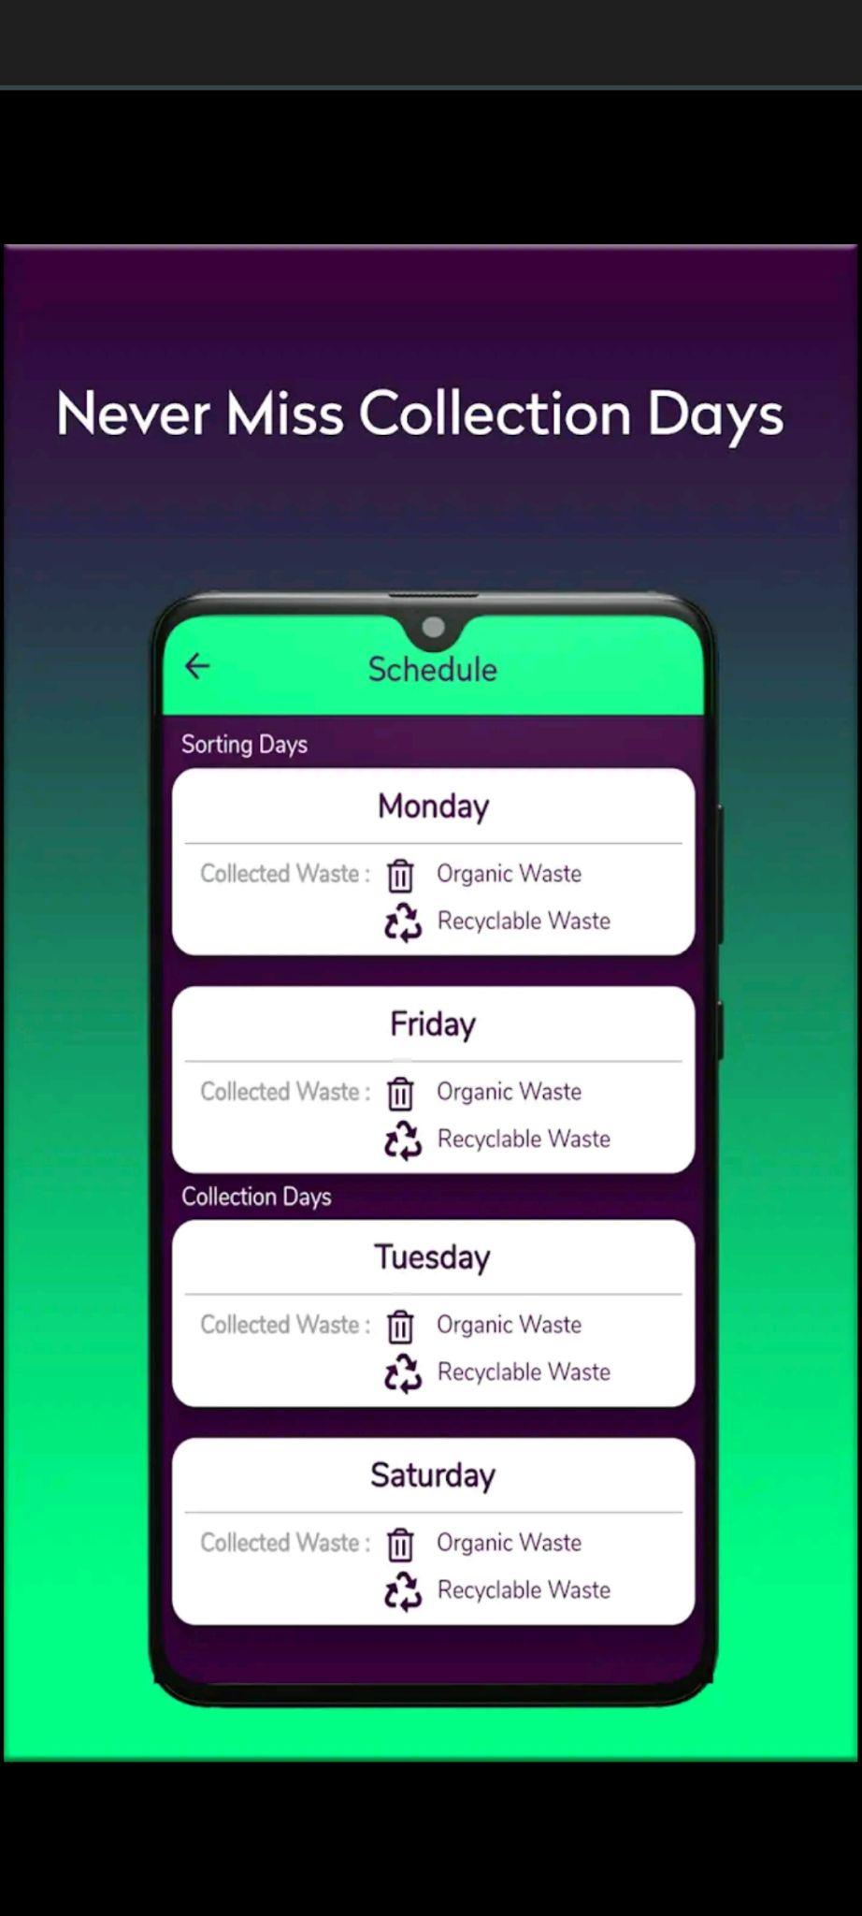
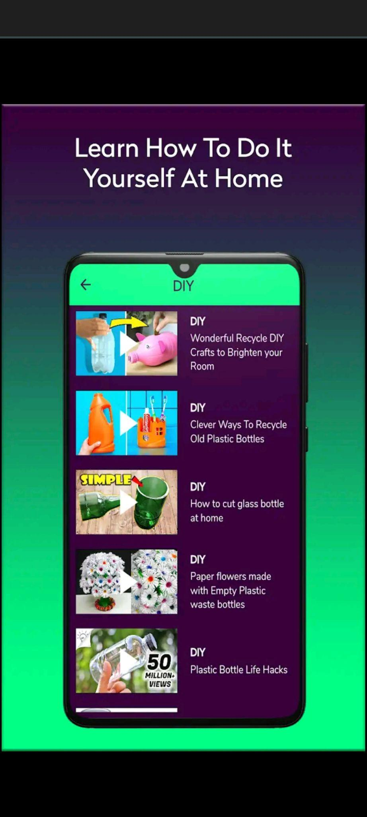
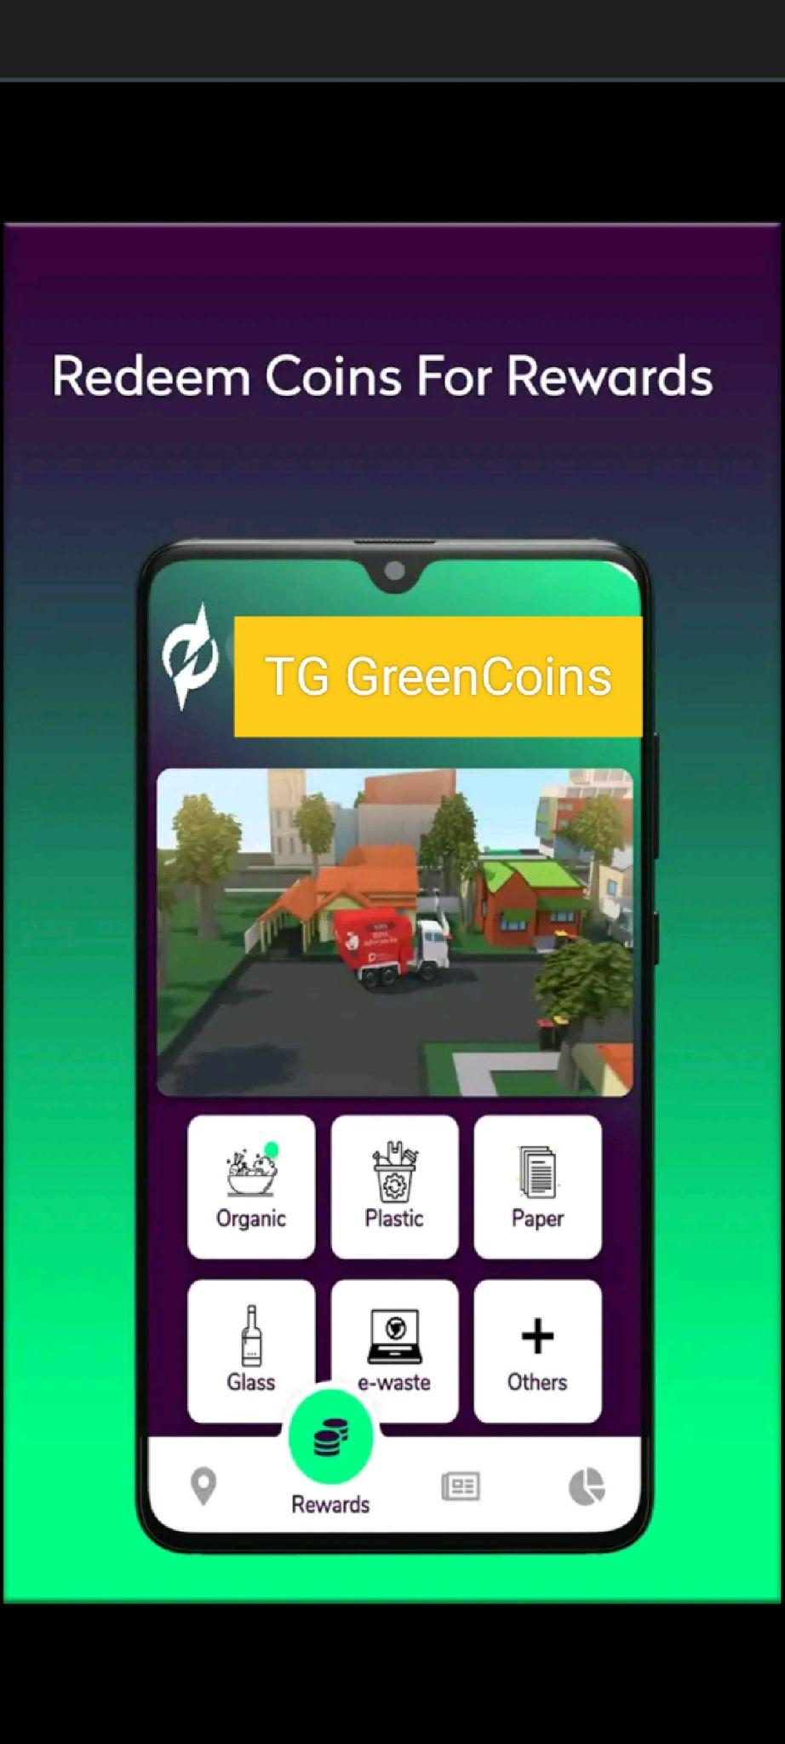
TrashGold Application Tutorial

Slide 10
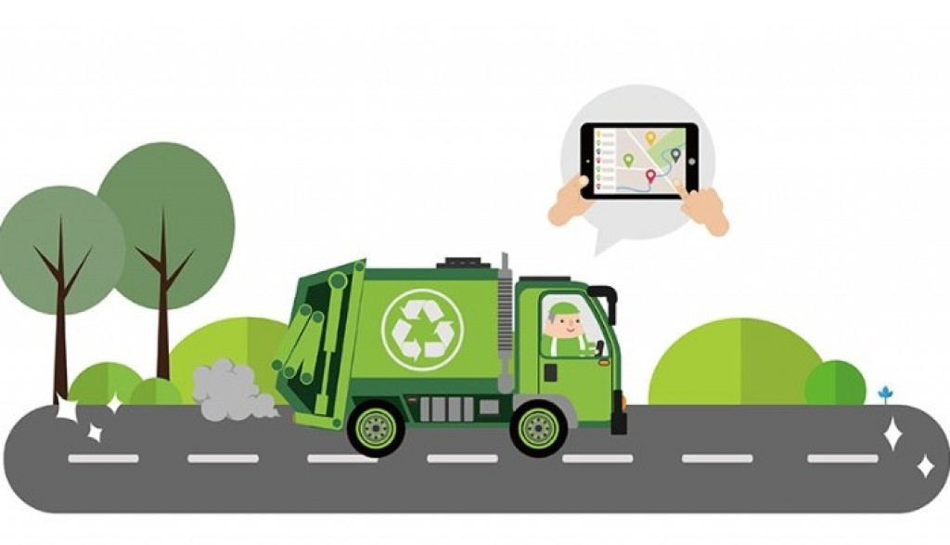
Swacchta Mitra and Door to Door collection

Slide 11
Behavioral Change Communication

Slide 12
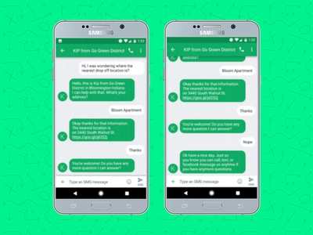
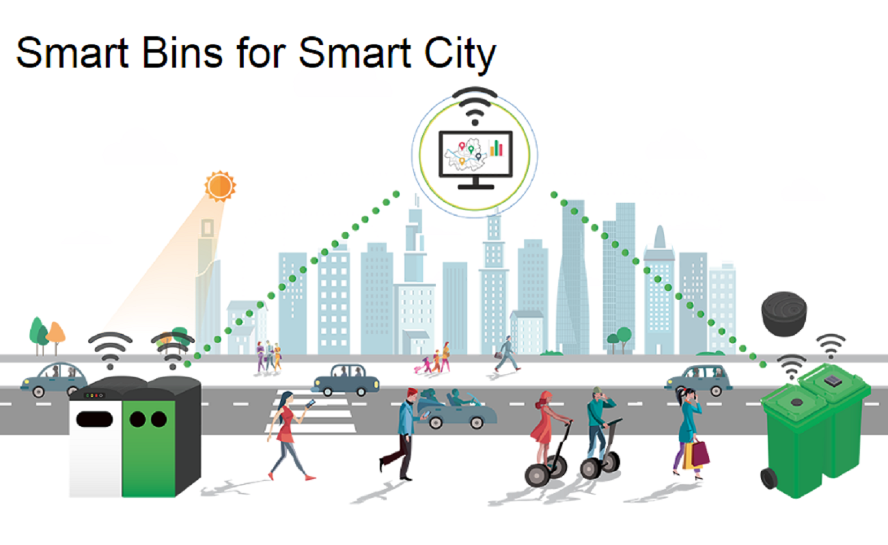
Digital Marketing and Grievance Redressal

Slide 13
Waste to Wealth Initiatives

Slide 14
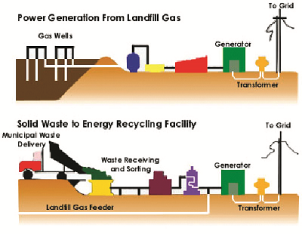
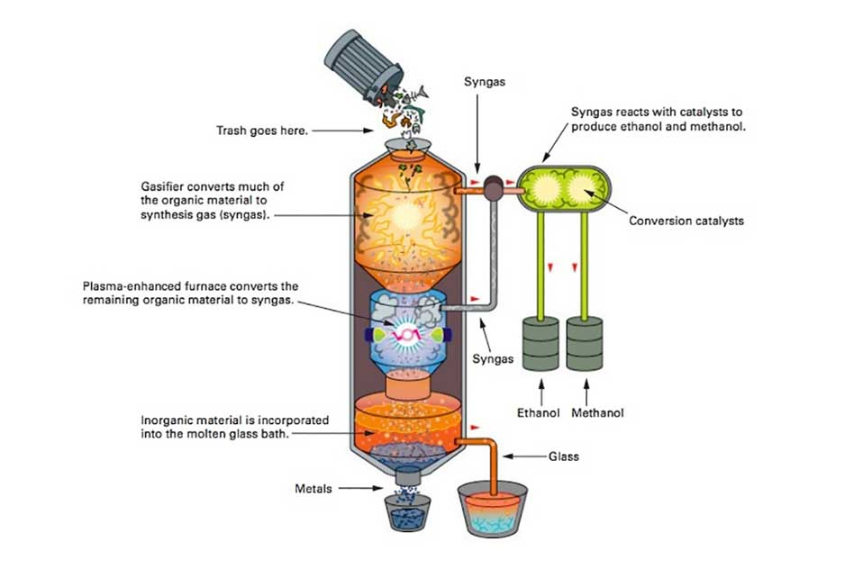
Organic Waste to Power Generation
Fuel Production

Slide 15
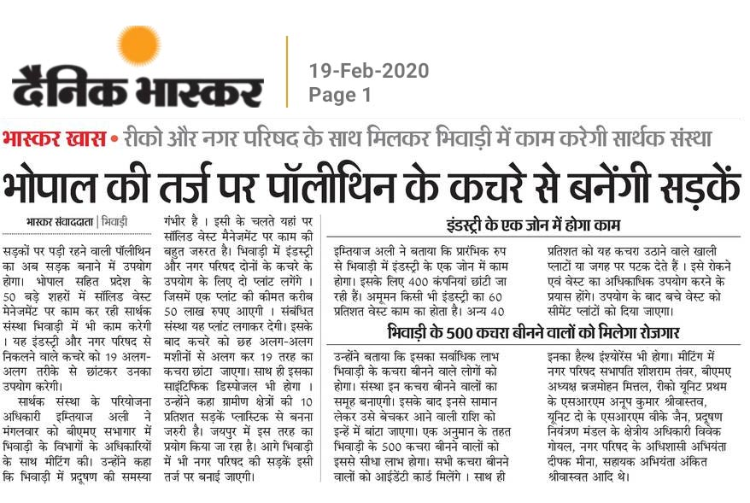
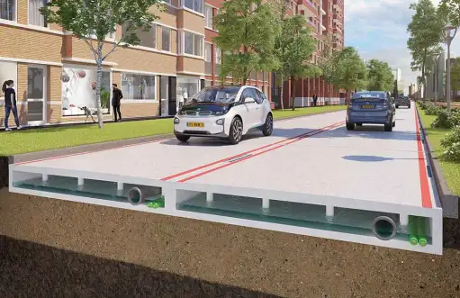
Use of plastic in building roads

Slide 16
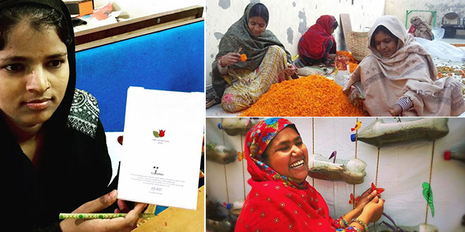
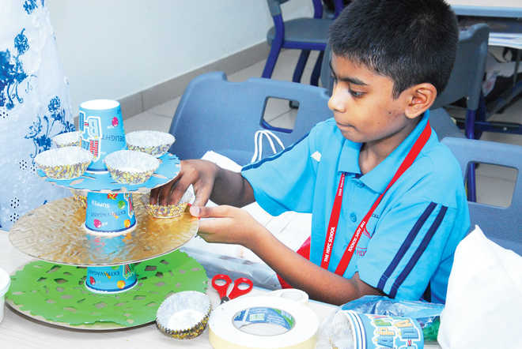
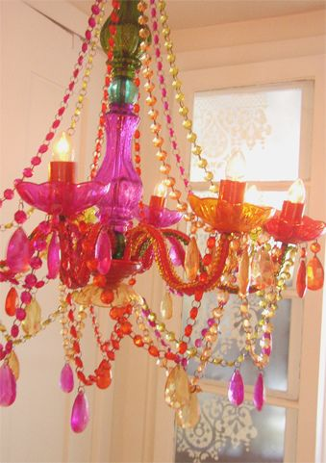
Vocational Trainings and collaborations for Skill India for Waste Management

Slide 17
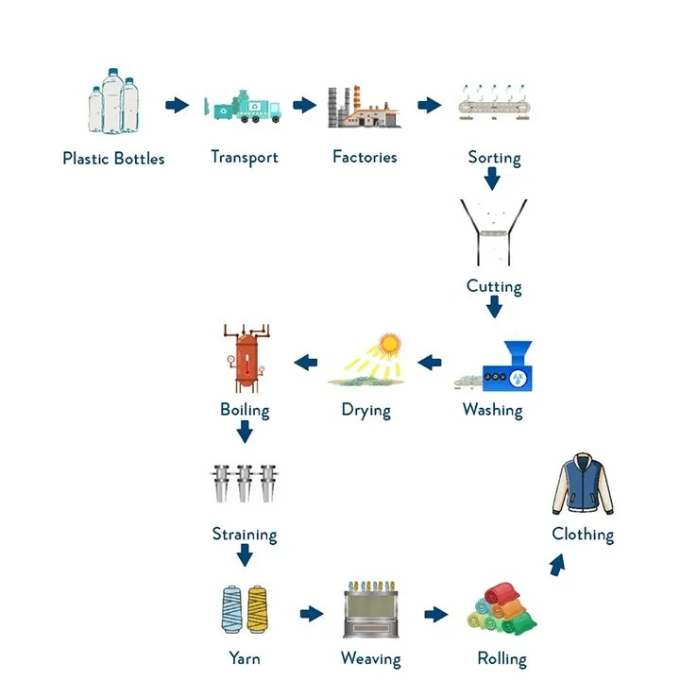
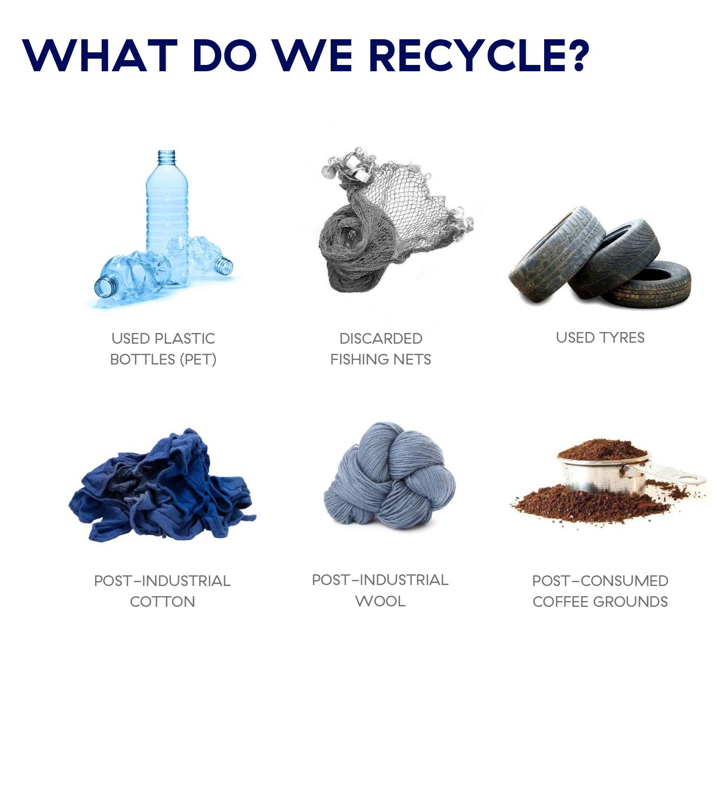
Product Launch: EcoTrendy Clothing (Going Zero Waste)

Slide 18
Thank You!
Team Nicolaus

